Slide 1
End-to end Tracing, tracing Kubernetes
Aditya Chechani
Joshua Manning
Reet Chowdhary
Runzhou Han
2/8/2018
Taiga: https://tree.taiga.io/project/msdisme-2018-bucs528-template-7/
GitHub: https://github.com/BU-NU-CLOUD-SP18/Cross-Layer-Tracing-in-Kubernetes
Notes:
‹#›

Slide 2
Container
*
Containers provide an isolated environment with a unique namespace
App may run with its environment
Apps can only use the resources defined in this namespace
Application
Web server, readable file system
Container
‹#›

Slide 3
Kubernetes
*
Kubernetes coordinates a highly available cluster of computers that are connected to work as a single unit
Kube automates distribution & scheduling of app containers across a cluster in a more efficient way
Master and Nodes
Master coordinates cluster
Nodes are workers that run applications
‹#›

Slide 4
Tracing
*
Tracing: Trace events labeled by a unique ID of a request to know apps’ behavior.
Tracing ID is a local variable
Propagation of request IDs tied to a specific request
API
API
API
API
”Thread” of Tracing ID
Request
Node1
Node2
‹#›

Slide 5
Vision & Goals
*
End-to-end tracing for app behavior on Kubernetes
Trace points (start time, stop time, annotations for remote procedure call)
RPC IDs
Identify issues (bottle necks, latency issues etc.)
Add in trace points to “data plane” features
Ingress - An API object that manages external access to the services in a cluster, typically HTTP.
Services - An abstraction which defines a logical set of Pods and a policy by which to access them - sometimes called a micro-service.
‹#›

Slide 6
Our Users
*
Bottlenecks
Facing these problems…
End-to-end tracing
Debug
Kubernetes users,
Including companies and individuals
Latency
Analyze
Performance
‹#›

Slide 7
Scope & Features
*
Instrument the services section of Kubernetes with trace points
Instrument the ingress features of Kubernetes with trace points
Focus on data-plane portion
‹#›

Slide 8
Example
*
Jaeger: a distributed tracing system used for monitoring microservices-based distributed systems donated by Uber.
OpenTracing: A new, open standard for instrumenting applications and OSS packages for distributed tracing and monitoring.
HotRod: a sample application that can find out drivers nearby.
‹#›

Slide 9
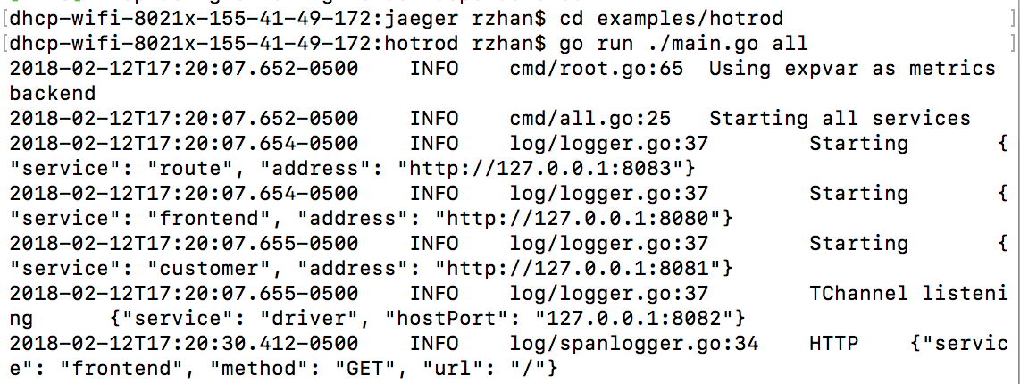
Example
We want to see all micro-services

Slide 10
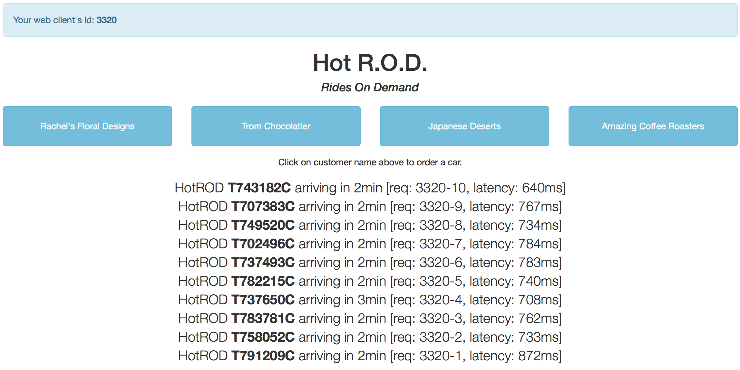
Example
A random ID
Client
Tracing ID

Slide 11
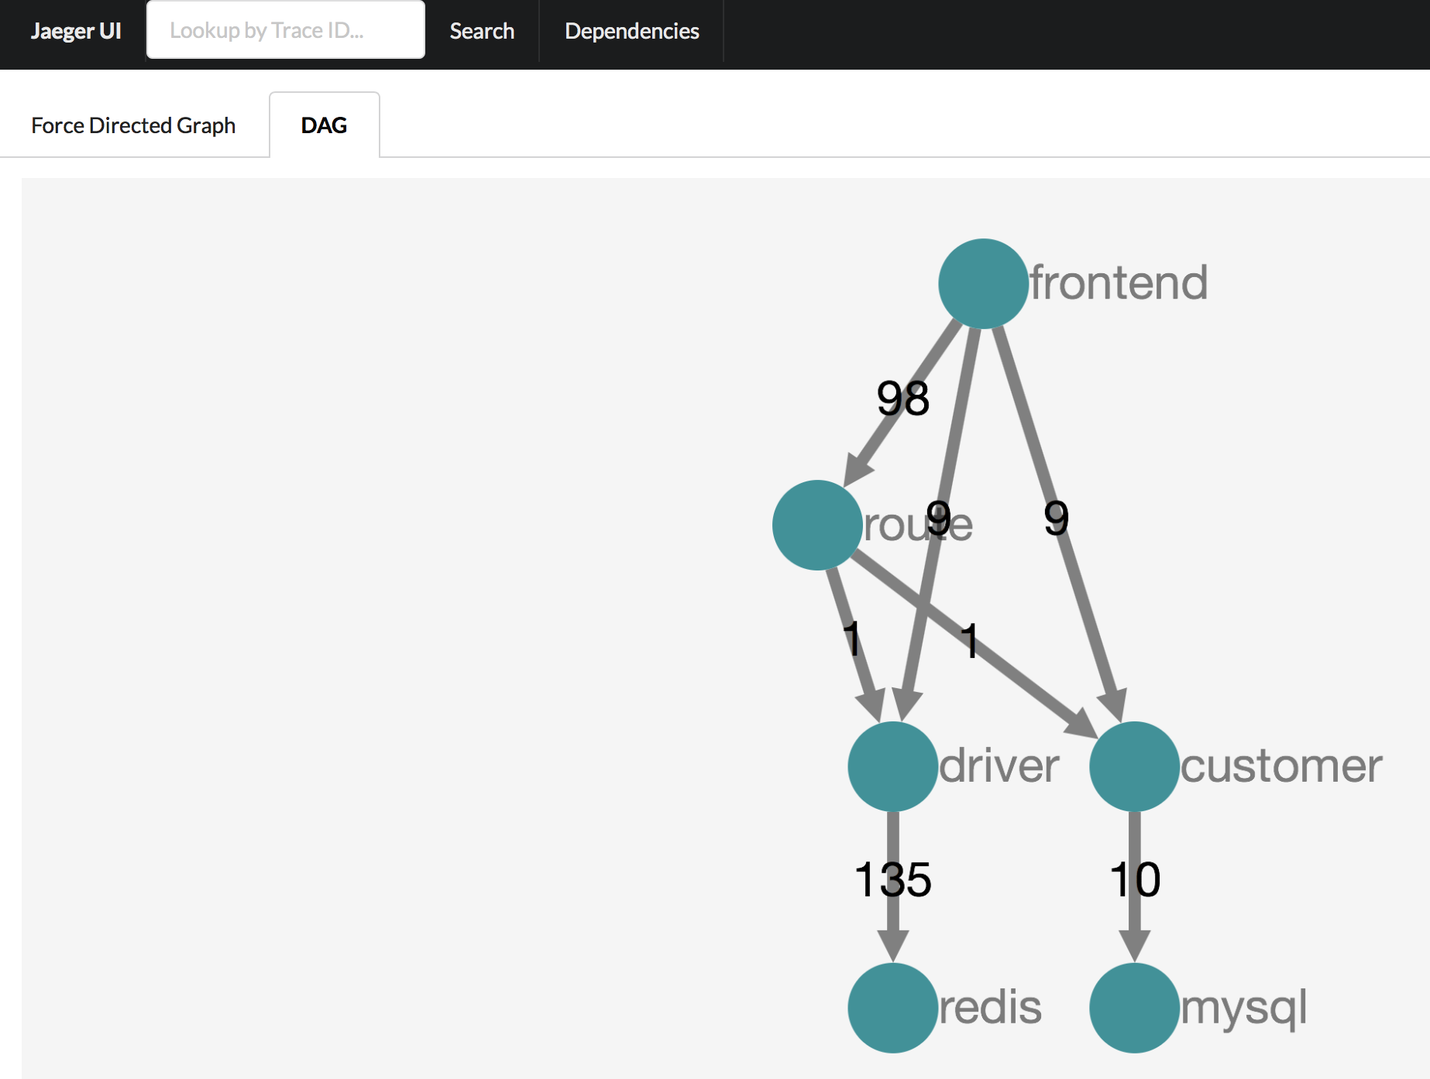
Example
Micro-service
Number of RPCs
Storage backend

Slide 12
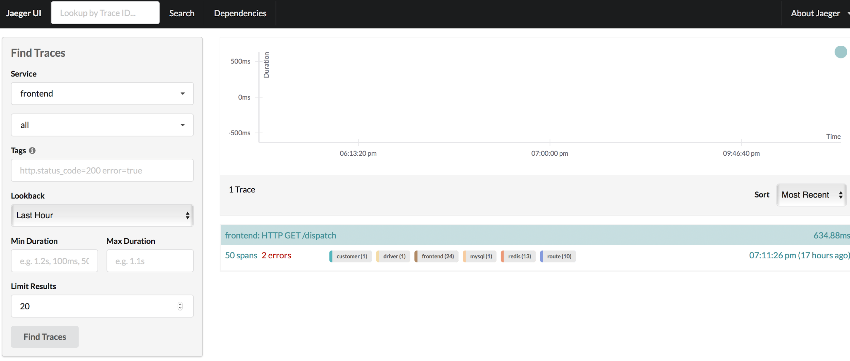
Example
Click here to see entire record and analysis

Slide 13
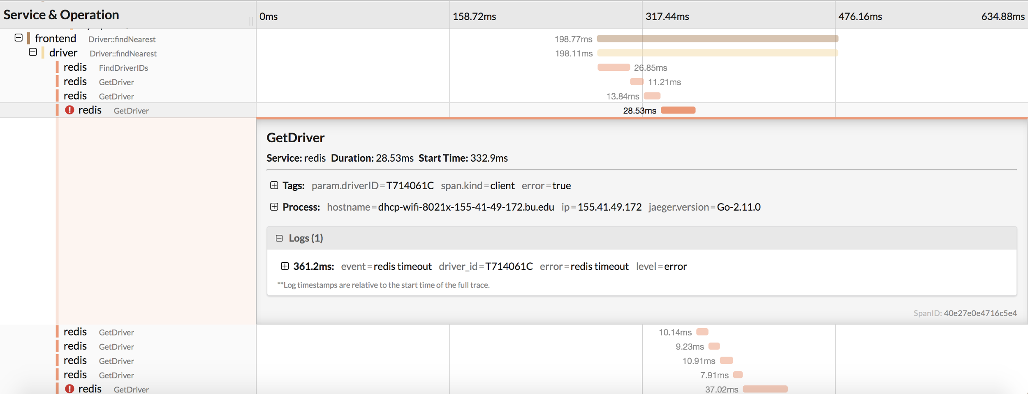
Example
The 2 errors
What causes the error?

Slide 14
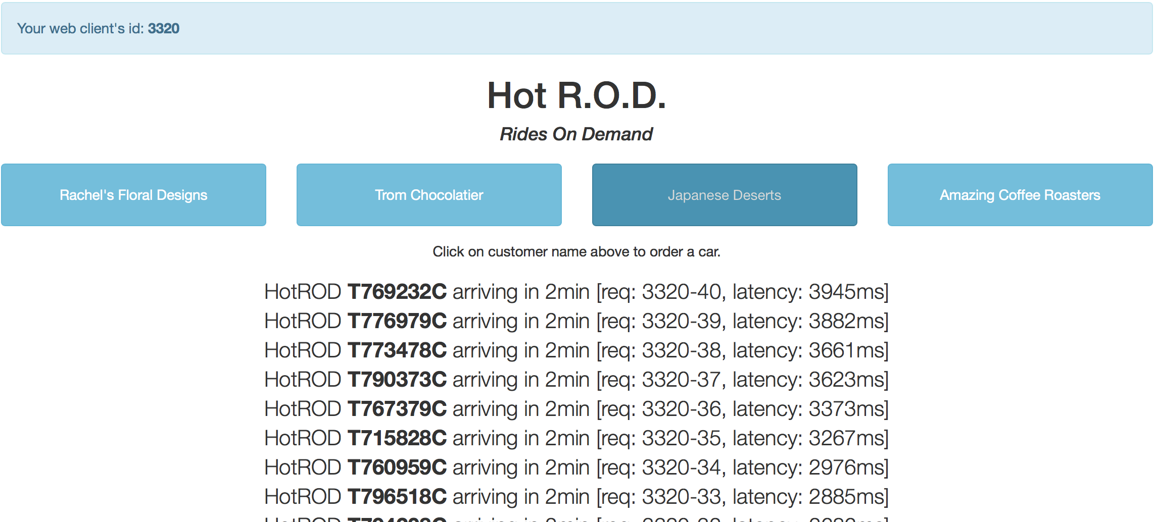
Example
Let’s go to the HotROD UI and click on one of the buttons repeatedly (and quickly).we can see, the more requests are being processed concurrently, the longer it takes for the backend to respond.
Jaeger can detect latency and bottlenecks and find out how to deal with them.
More information click here

Slide 15
Trello
Acceptance Criteria
Implement end-to-end tracing for n number of requests to a distributed system containing at least n number of machines in parallel through the Kubernetes data-plane.

Slide 16
Release Planning
Short Term Goals:
Get Kubernetes on our machines
Create and run applications in containers
Run HotRod using Jaeger backend to see traces
Tutorials on Kubernetes & tracing
‹#›

Slide 17
THANK YOU
*
‹#›

